Slide 1
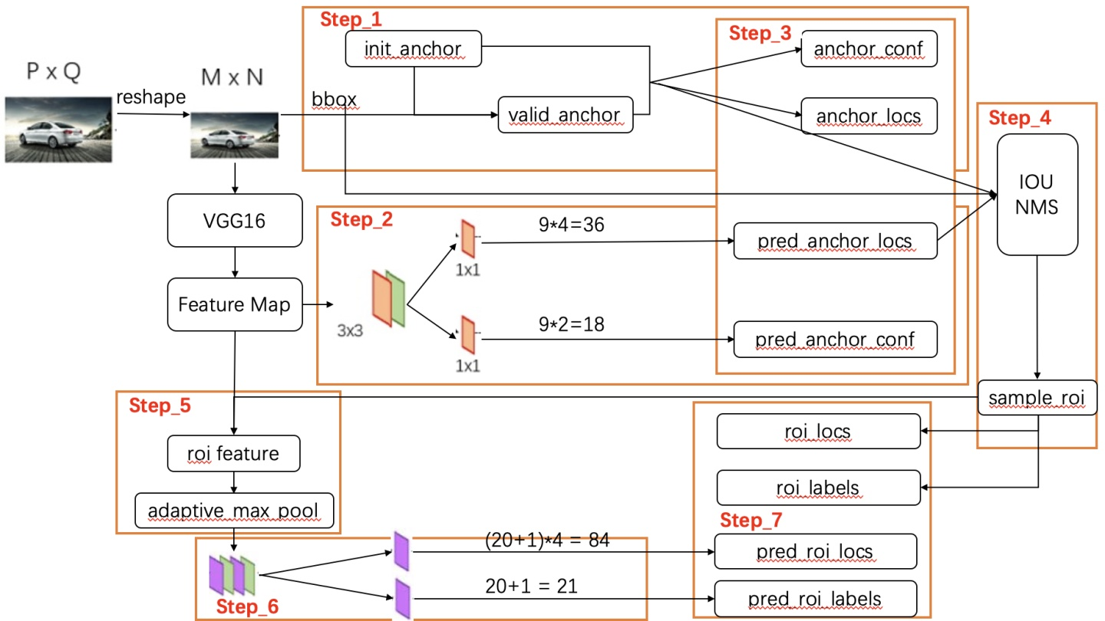
Faster RCNN

Slide 2

RPN
box target
Anchor target layer
RPN
labels
变化图片尺寸
anchors
bbox
backbone
RPN
Predict bbox
RoI
Score
feature
RPN
RPN
classify prob
RoI
proposal
target layer
Faster rcnn
target bbox
labels
Faster RCNN
predict bbox
classify score

